Slide 1
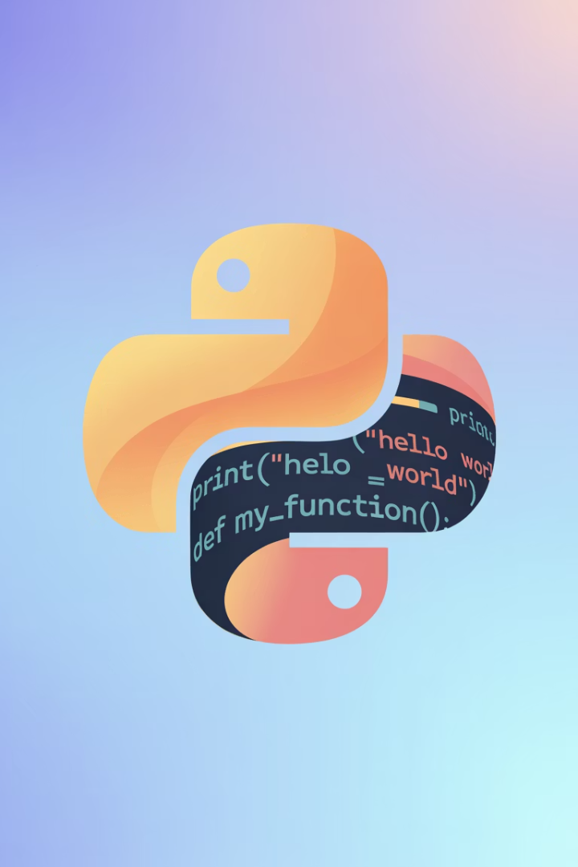
Introduction to Python Programming
Python is a high-level programming language used to build websites, apps, games, data tools, and AI systems. This presentation will guide you through the basics of Python programming.
LW
by Liang Wang

Slide 2
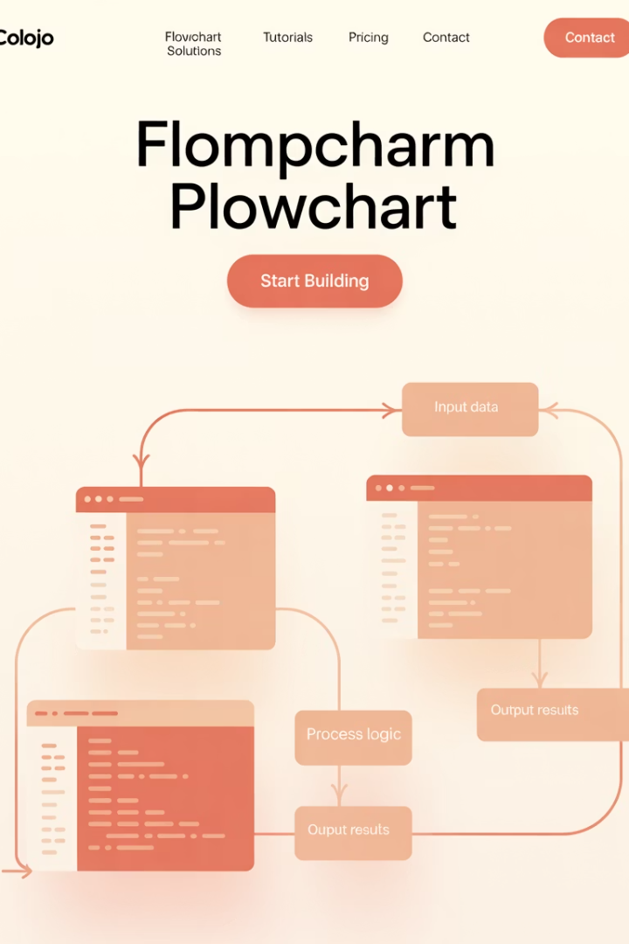
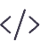


What is a Program?
Set of Instructions
Logical Sequence
A program is a set of instructions that tells a computer what to do.
Instructions are executed in a specific order to perform tasks.
Computer Language
Programs are written in languages computers can understand.

Slide 3
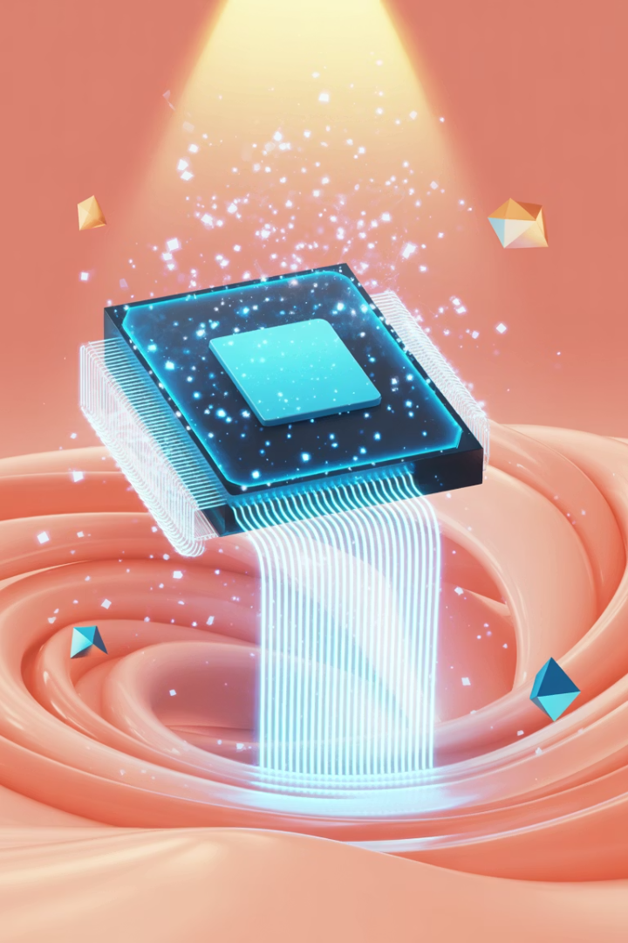

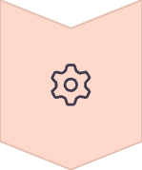
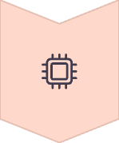

How Does a Program Run?
Source Code
Human-readable instructions written by programmers
Compilation/Interpretation
Code is translated into machine language
Execution
Computer processes instructions and performs tasks
Output
Results are displayed to the user

Slide 4
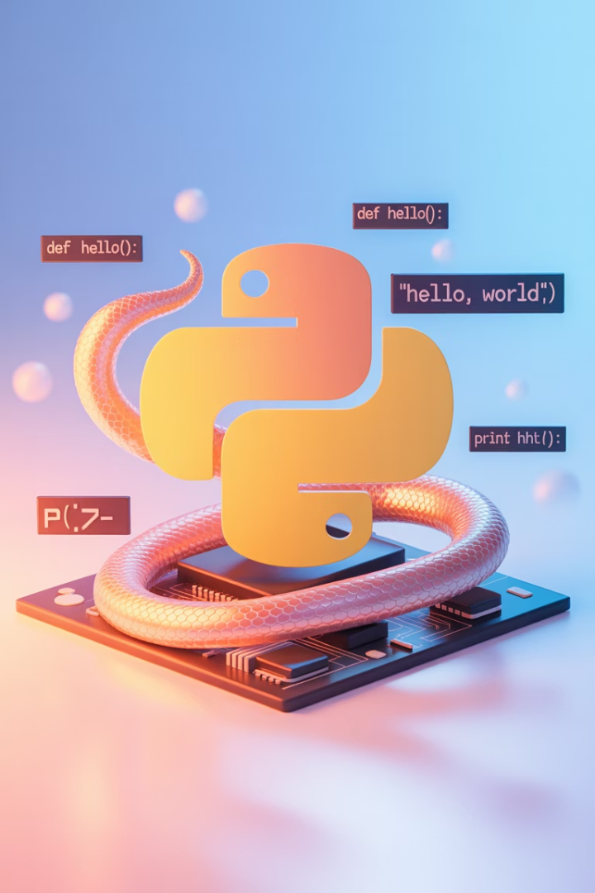
What is Python?
High-Level Language
Versatile Tool
Python uses simple, English-like syntax that's easy to read and write.
Used to build websites, apps, games, data tools, and AI systems.
Interpreted Language
Code is executed line by line, making debugging easier.

Slide 5








Why Use Python?
Simple Syntax
For Everyone
Easy to read and write, resembling English.
Great for beginners and professionals alike.
Versatile
Industry Standard
Supports web dev, automation, AI, and more.
Used by Google, YouTube, NASA, and more.

Slide 6
Python vs C-Style Languages
Python
C-Style Language
# Print numbers 1-5
for i in range(1, 6):
print(i)
// Print numbers 1-5
for (int i = 1; i <= 5; i++) {
printf("%d\n", i);
}
Simple, readable, and concise code with minimal syntax.
More complex syntax with additional symbols and structure.

Slide 7
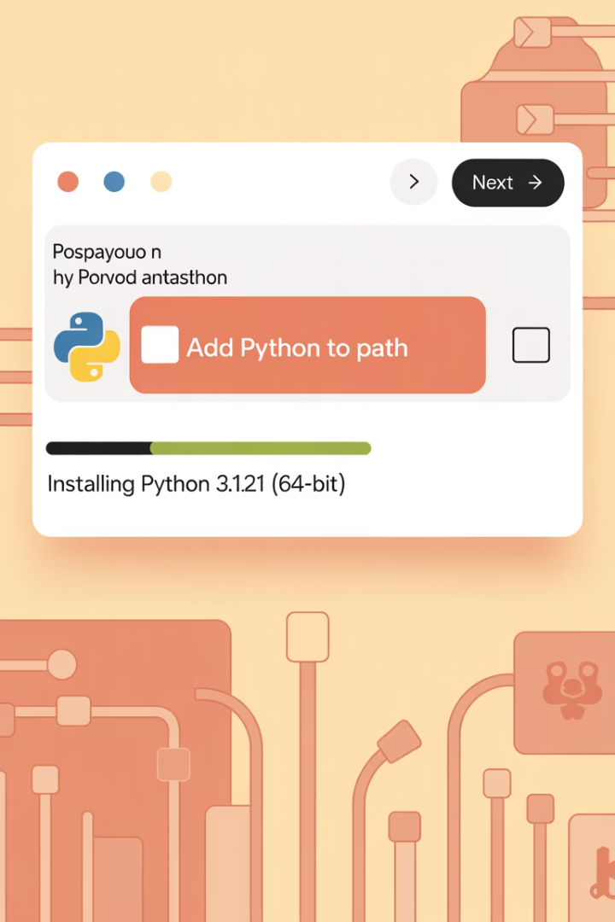
Installing Python
Download Python
Visit python.org and download the latest version.
Run Installer
Check "Add Python to PATH" during installation.
Verify Installation
Open terminal and type: python --version

Slide 8
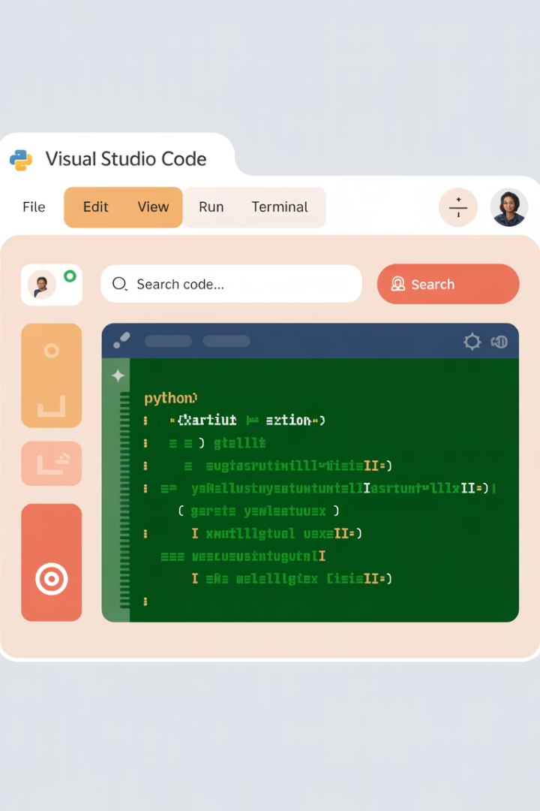




Setting Up an IDE
Download VS Code
Get VS Code from the official website.
Install Python Extension
Add the Python extension from the marketplace.
Create a Project Folder
Make a dedicated folder for your Python projects.
Test Setup
Create and run a simple Python file.

Slide 9



Your First Python Program
Create a new file
Open your IDE and create hello.py
Write your code
Type: print("Hello, World!")
Run the program
Press Run or F5 to execute

Slide 10
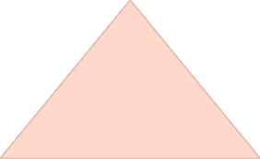

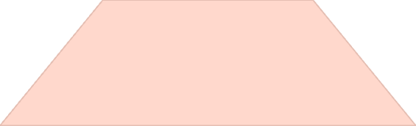
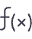
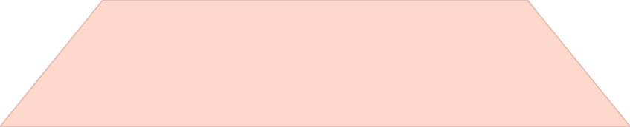
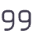
How print() Works
Output
Text appears on screen
Function Call
print() sends data to output
String Data
Text enclosed in quotes

Slide 11
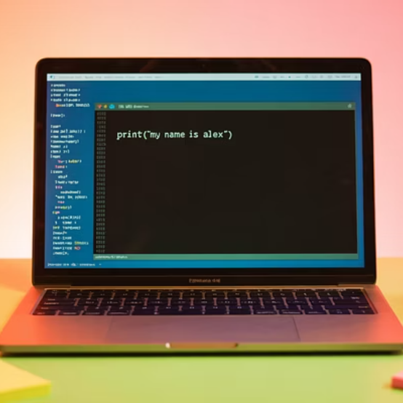
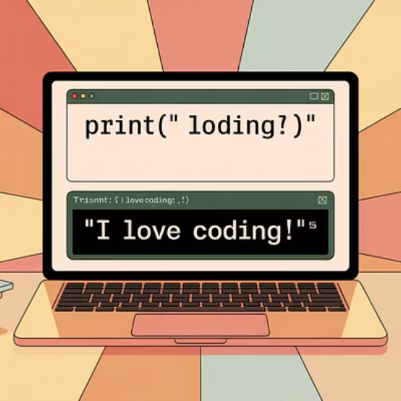
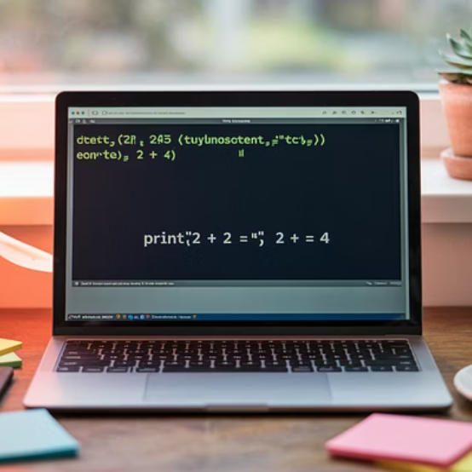
Hands-on Practice with print()
Try these examples in your IDE. Notice how print() can display text, numbers, and even perform calculations.

Slide 12
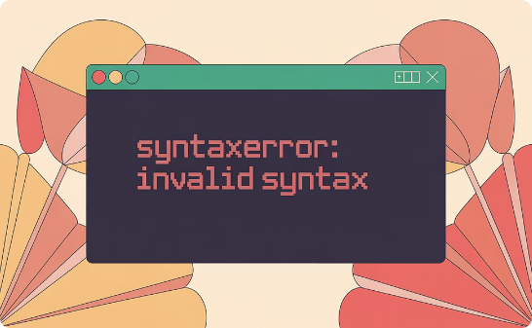
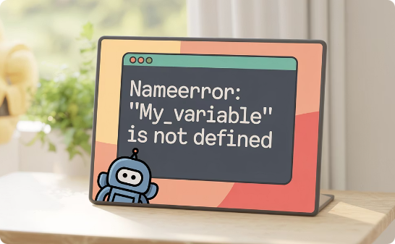
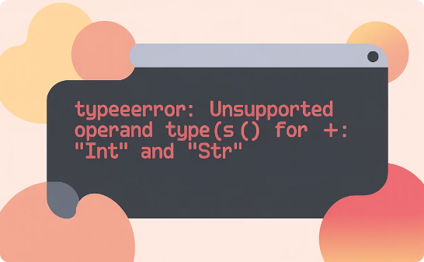
Understanding Python Errors
Syntax Errors
Name Errors
Type Errors
Occur when Python can't understand your code structure.
Happen when Python can't find a referenced name.
Result from operations on incompatible data types.

Slide 13
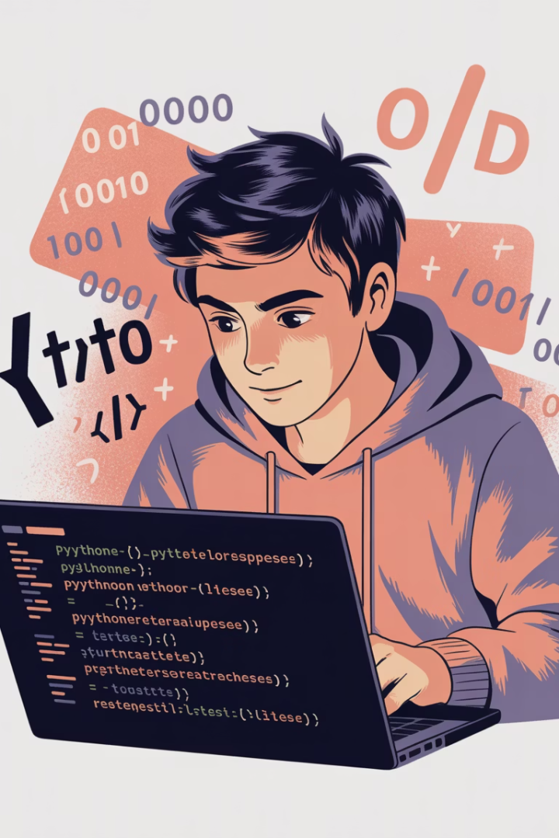
Exploring Error Messages
Code with Error
Error Message
Explanation
prin("Hello")
NameError: name 'prin' is not defined
Misspelled function name
print("Hello"
SyntaxError: unexpected EOF
Missing closing parenthesis
print(5 + "text")
TypeError: unsupported operand
Can't add number and string

Slide 14



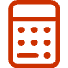

Practice Suggestions
Personal Info
Debug Challenge
Math Expressions
Write a script that prints your name, age, and favorite subject.
Intentionally make an error, then fix it.
Try printing calculations like 5 + 3 and 10 / 2.
Add Comments
Use # to add explanations to your code.

Slide 15
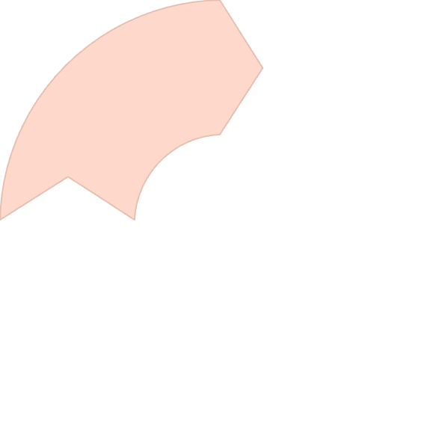
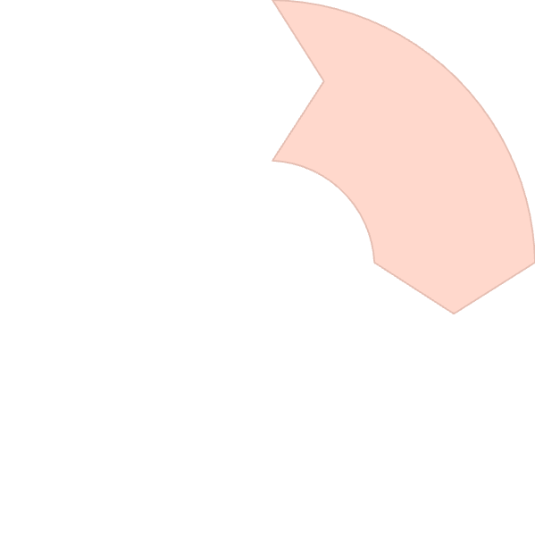






Next Steps in Your Python Journey
Learn Variables
Explore Data Types
Store and manipulate data in your programs
Work with numbers, strings, lists, and more
Build Projects
Master Control Flow
Apply your skills to create useful programs
Use if-statements and loops for decision making

